Slide 1
Denoising convolutional auto-encoder

Slide 2
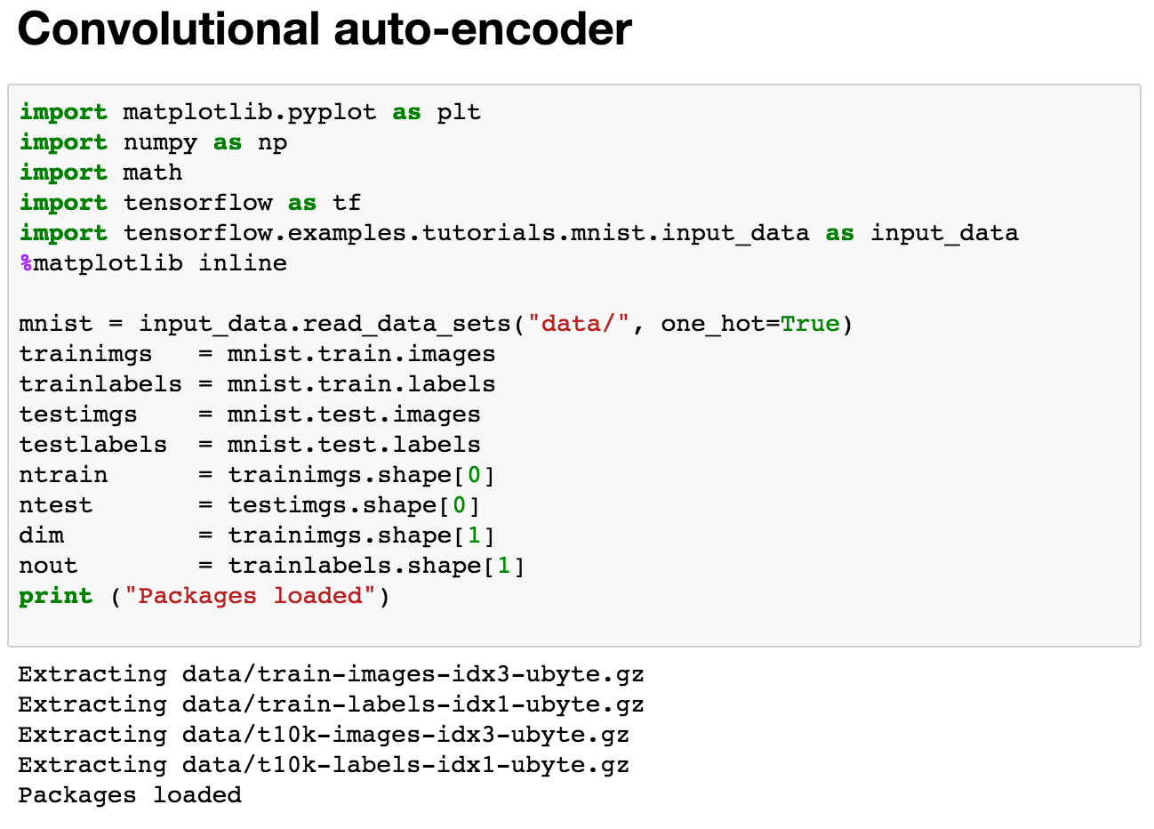
Load

Slide 3
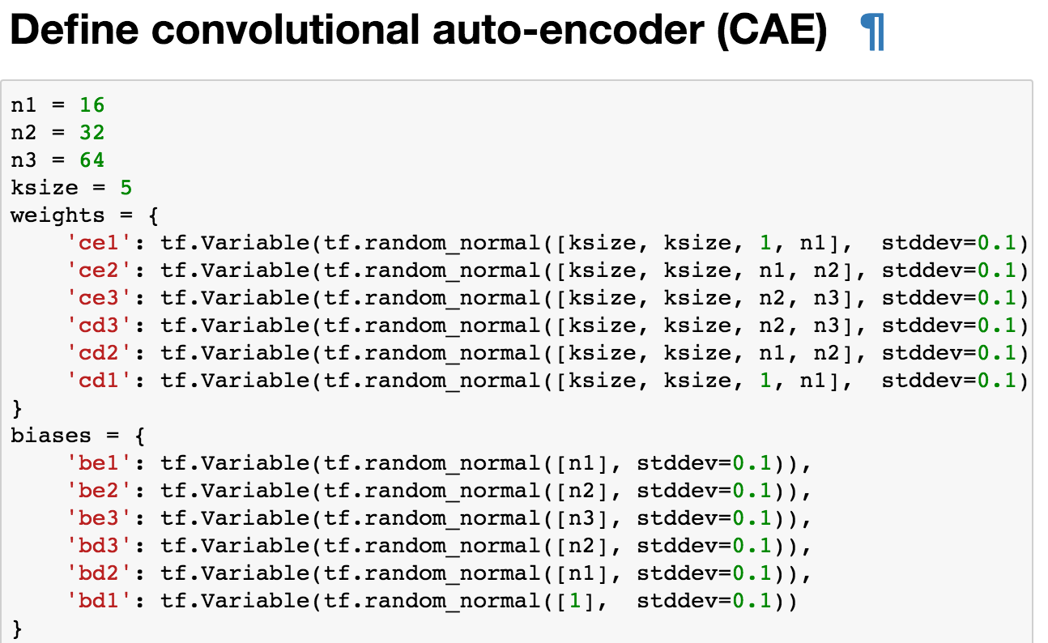
Network

Slide 4
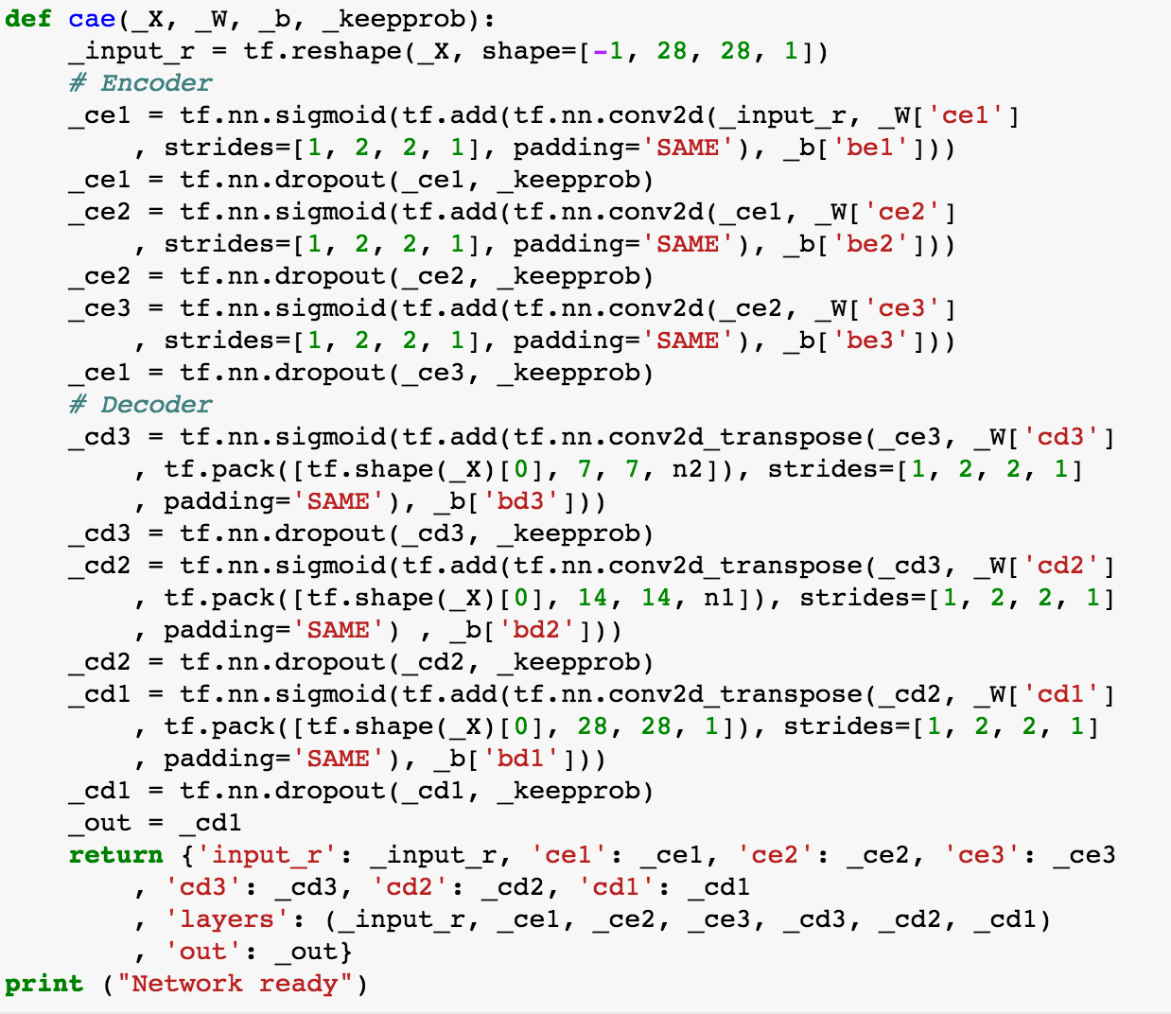
Network

Slide 5
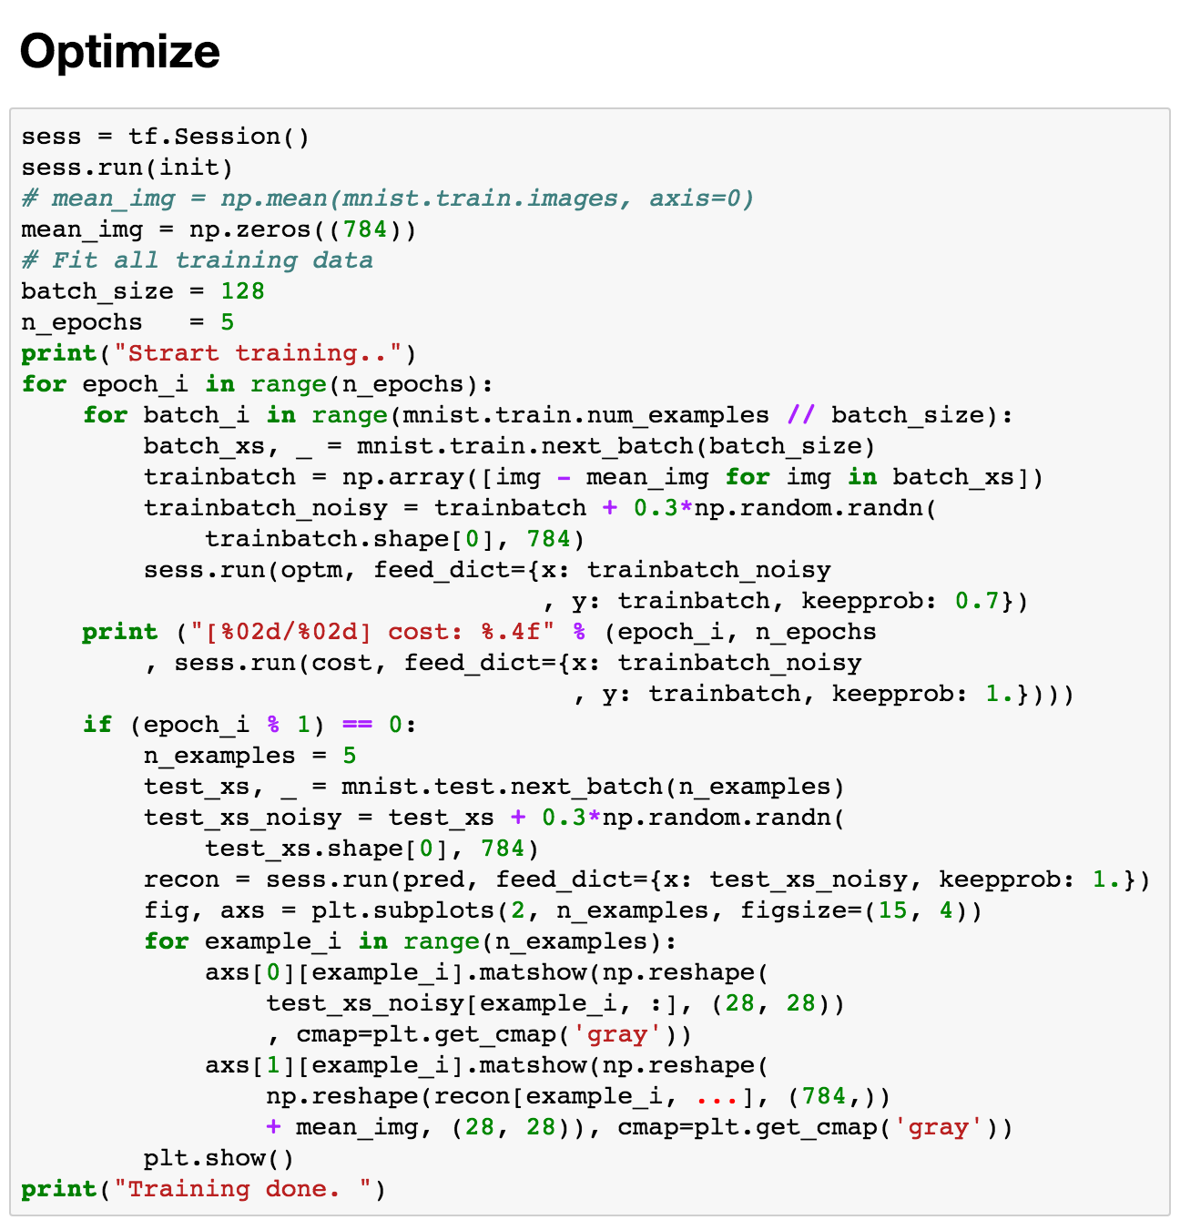
Optimize

Slide 6
Epoch: 1

Slide 7
Epoch : 2

Slide 8
Epoch : 3

Slide 9
Epoch : 4

Slide 10
Epoch : 5

Slide 11
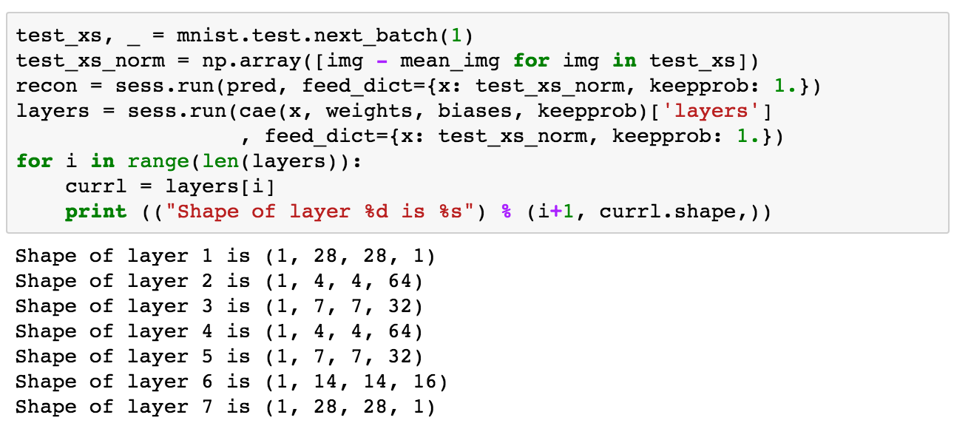
Shape

